Slide 1
Value Proposition Template: Product Name
Persona
A specific group of people sharing the same Jobs to be Done
Date
mm/dd/yyyy
Job to be Done | Problem context (what before) | Features and capabilities (how) | Benefits and outcomes (what after) | Alternatives
The job your customer cares about | Existing, problematic state (e.g., maintaining tasks in Excel) | Features and capabilities that change the situation (e.g., Kanban board) | The benefits and outcomes (e.g., organized tasks with clear deadlines, increased productivity) | Your value, unique attributes, and optionally relative pricing vs. alternatives
Second job to be done
Third job to be done
Copyrights: The Product Compass & Behind Product Lines, Attribution-ShareAlike 4.0

Slide 2
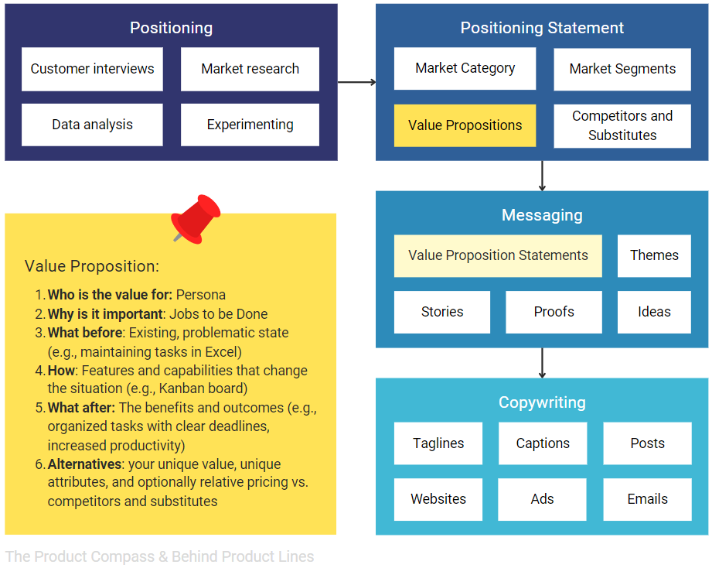
Definitions: Positioning vs Messaging vs. Copywriting
A full post: How to Design a Value Proposition Customers Can't Resist?

